Slide 1

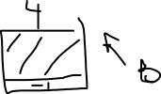








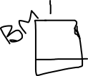





Notes:
Contiguous

Slide 2



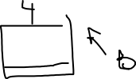

Notes:
chain

Slide 3
Notes:
index

